Slide 1
Stream I/O and File Processing
Department of Computer Science & IT,
The University of Lahore

Slide 2
Interactive vs. Batch Processing
Interactive Program
the program halts, and waits for a user to enter data from the keyboard, then proceeds...
Batch Processing Programs
Non-interactive input and output
User and computer do not interact while the program is running
Data is stored as a separate file on a disk

Slide 3
What are FILEs in C/C++
Storage of information in variables/arrays or pointers is (temporary).
Files are used for permanent retention of data. (Never lost during shut down or power failure).
Permanent retention can be Hard Disk, Flash Drives, Floppy Disks, CD ROMs etc.

Slide 4
Type of FILES
Text type files
Text type files are easily readable by humans, Example include (*.txt, *.cpp, *.c, *.h).
Binary type files
Binary type files can’t be readable or modify able by the humans.
Only a particular software can open and edit these FILES.
Example include (*.gif, *.bmp, *.jpeg, *.exe, *.obj, *.dll).

Slide 5
FILE accessing in Computer Science
We can access the contents of any FILE with the help of two types:
Sequential access.
Direct access (Random access)
Sequential Access
Files contents are accessed sequentially (from first to desired content).
In order to access the location 101th, we must have to first traverse all contents from 0 to 100. Then the 101th location could be accessed.
(Normally slow if we want to access random contents in a file). Random access is especially used in Databases.

Slide 6
Sequential Access FILE (Example)
To access the data of the candidate of NIC# 5.
We have to follow the following 3 steps.
First open the file.
Must have to traverse all contents of NIC# 1, 2, 3 and 4. Then finally we can access NIC# 5 data.
Close the file.
NIC# | Candidate Name | Age
1 | R. Agrawal | 32
2 | R. Srikant | 25
3 | C. Bettini | 23
4 | D. Burdick | 40
5 | R. Zaki | 21
6 | …. | 26
7 | …. | 35

Slide 7
Streams
Stream
a channel where data are passed to receivers from senders.
Output Stream
a channel where data are sent out to a receiver
cout; the standard output stream (to monitor)
the monitor is a destination device
Input Stream
a channel where data are received from a sender
cin; the standard input stream (from the keyboard)
the keyboard is a source device

Slide 8
Stream Processing
Five operations necessary for stream processing
the stream must be opened for use
if it’s an input stream, get the next element
detect the end of the input stream
if it’s an output stream, put the next element
close the stream

Slide 9
Standard Input / Output Streams
Standard Streams use #include <iostream>
Standard Input Stream
cin names the stream
the extractor operator >> extracts, gets, or receives the next element from the stream
Standard Output Stream
cout names the stream
the inserter operator << inserts, puts, or sends the next element to the stream
Opening & closing of the standard streams occur automatically when the program begins & ends.

Slide 10
File Streams
Files
data structures that are stored separately from the program
Input File Stream
extracts, receives, or gets data from the file
Output File Stream
inserts, sends, or puts data to the file
#include <fstream> creates two new classes
ofstream (output file stream)
ifstream (input file stream)

Slide 11
Output File Streams
#include <fstream>
allows use of the two classes: ofstream, ifstream
ofstream out_file;
a variable or object (out_file) is declared to be of type or of the class ofstream
out_file.open(“myfile.dat”);
connect the output file stream to a file on the disk in the default directory named “myfile”
if “myfile” exists it is opened for output & connected to the data stream out_file. If data is there, it is erased!
If “myfile” doesn’t exist, it is created & connected to the data stream out_file

Slide 12
Output File Streams
General Form for output file stream
ofstream <stream variable name>;
<stream variable name>.open(<file name>);
the stream variable name can be any valid C++ identifier (out_file is a good name to use)
The file stream should be closed when you are finished. If out_file is the variable name then:
out_file.close( ) //no file name parameter used

Slide 13

Errors Opening & Closing Files
C++ has a “fail” function for use with file streams
#include <fstream.h>
#include <assert.h>
. . .
ofstream out_file;
. . .
out_file.open(“myfile.dat”);
assert( ! out_file.fail( ));
//send data to the file
out_file.close( );
assert( ! out_file.fail( ));

Slide 14
Output Streams: Point 1
Operations on output streams are abstract.
Abstract: hiding the details
It doesn't matter if the output stream is a file on a disk or the monitor screen.
We only need to know the name of the stream to send the data to the stream
use cout for the monitor or out_file for a data file
out_file<<“This is going to the data file.”;
cout<<“This is going to the monitor screen.”;

Slide 15
Output Streams: Point 2
Programs using output streams are portable.
Portable: can be transferred to another application or computer platform, and be recompiled without having to change the code.
This works even if the different platform uses a different method of saving files to a disk.

Slide 16
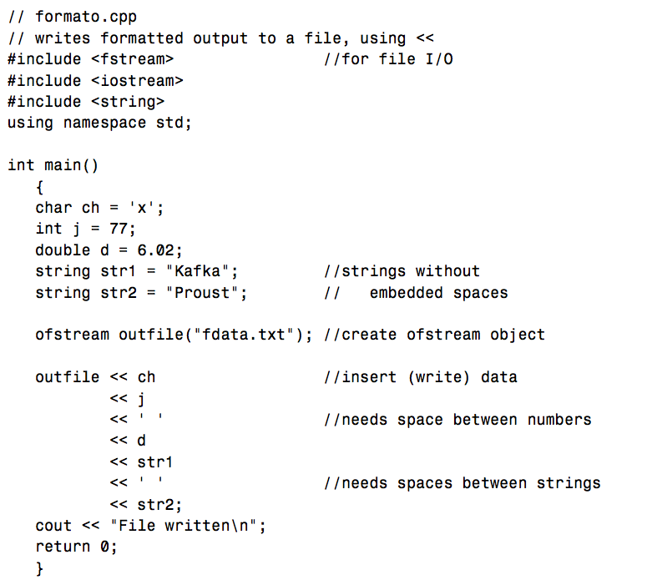

Slide 17
Input File Streams
#include <fstream>
allows use of the two classes: ofstream, ifstream
ifstream in_file;
a variable or object (in_file) is declared to be of type or of the class ifstream
in_file.open(“myfile.dat”);
connect the input file stream to a file in the default directory
if “myfile” exists, it is opened for input

Slide 18
Input File Streams
General Form for input file stream
ifstream <stream variable name>;
The file stream should be closed when you are finished:
in_file.close( ) //no file name parameter used

Slide 19
Using Input File Streams
Input Streams
we use the >> extractor operator to get data from the keyboard
With the Standard Input Stream
user enters characters from the keyboard followed by a blank space, tab
The computer converts the characters into the data type represented by the identifier used
int, double, char

Slide 20
Example
Input Streams
we use the >> extractor operator to get data from the data file
With the Input File Stream
Some user has already entered characters from the keyboard followed by a blank space, tab into a data file
We need to know:
what type of data is stored in the file
int, double, char
what order the data is stored
sometimes even what type of whitespace separates the data
blank spaces, tabs

Slide 21
Loops And Input File Streams
We don’t always know precisely how many data values are in a file
read data while the end of the file has not been reached (eof)
eof returns true → “end of file marker”,
Otherwise eof returns false

Slide 22
Input File Stream Example
in_file>> data;
while( ! in_file.eof( ))
{
process (data);
in_file>> data;
}
Notes:
You must read the first data item before checking to see if it is the eof.
A while loop (pretest) will prevent trying to read data beyond the eof marker. (the first item could be eof, in an empty file.)
Don’t forget to read the data again inside the loop to update the Boolean expression and avoid infinite loops.

Slide 23
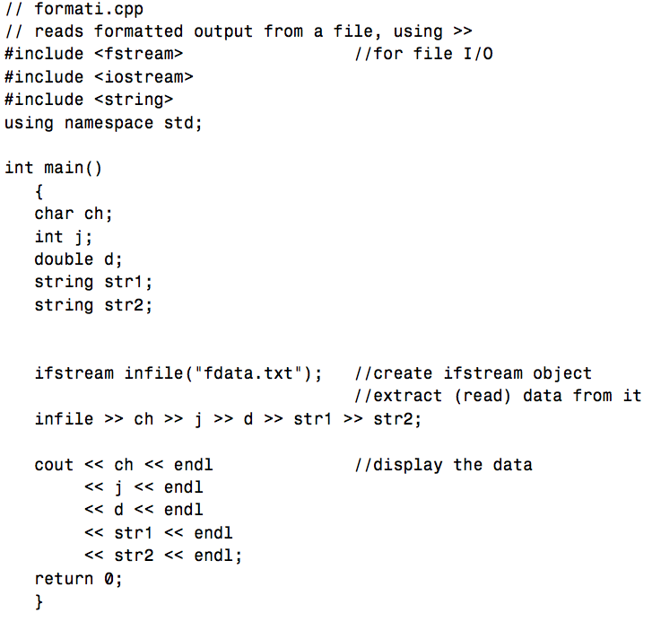

Slide 24
Compiler Differences
Some compilers will indicate that the eof has been reached if file stream function fail ( ) returns true.
Use this compound Boolean Expression to guard against this:
while( (! in_file.fail( ) ) && ( ! in_file.eof( ) ) )

Slide 25
Files and Strings
Files containing strings can be processed:
a string (word) at a time using a string variable
a line of strings at a time
using getline from the string library
getline is limited to 1024 characters per line
remember with getline, the end of line character is not stored with the actual line of text
or a character at a time
necessary to handle white space characters

